Slide 1
Therapeutic Parenting
Notes:
This template can be used as a starter file for a photo album.

Slide 2
What is therapeutic parenting?
A parenting response to trauma and attachment disruption that drives the parenting response
Not a common sense approach to behaviour management
A child centred approach (vs fixing)

Slide 3
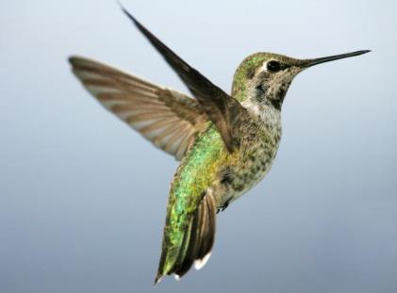
Kindship/Adopted or Permanent Care Children Experience
Attachment disruption
Compounding trauma
Loss of country, culture or parents
Resulting in complex emotional and behavioural needs

Slide 4
Outcome of early trauma on sense of safety
IMPACT:
Isolation
Trust
Disassociation
Depression
Anxiety
Hyper-Arousal
ADHD
Defiance

Slide 5
TRUST
DEPRIVATION
DISENFRANCHISED GRIEF
PERVASIVE SHAME
REGULATION
IDENTITY

Slide 6
Behaviour Model
Good Behaviour
Bad Behaviour
Rely on Control and Consequences = INEFFECTIVE PARENTING
Increases shame
Decreases loveability
Promotes conditional acceptance

Slide 7
Focus
Focus on addressing the child’s needs
Behaviour = Communication
Chop off the limbs or
Get to the roots

Slide 8
HOW TO OF THERAPEUTIC PARENTING
Routines/structure:
guide and comfort/safety.
No surprises.
Nurture:
with body language, voice tone and eye contact. Explore rather than chastise to reduce fear and achieve self regulation.
Empathy! Time-in. Joy and playfulness. Curiosity.
Name their need. Accept the child.
Allow natural consequences linking cause and effect.
Take care of self:
purposeful parenting requires lots from you.
Always appear as the Queen! Repair relationships fast.

Slide 9
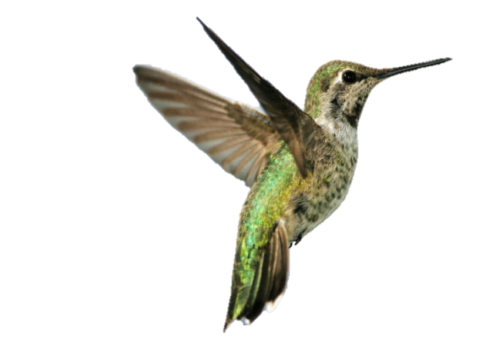
Normalise, Restore and Reflect
oneself and ones child

Slide 10
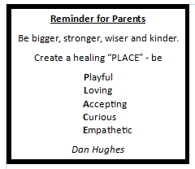
Parenting Plus Snapshot
Parenting Plus Cards
Parenting from PLACE

Slide 11
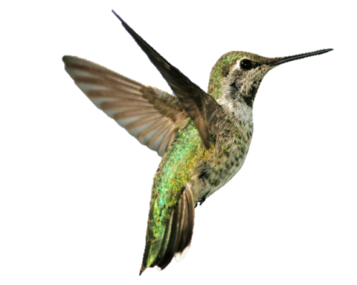
Benefits:
open communication
conflict resolution
Increase in shared interests and values
stronger relationships
Cortisol in flight or flight: turn the alarm clock off!

Slide 12
References
National Association of Therapeutic Parents
Sarah Naish - The A to Z of Therapeutic Parenting Strategies and Solutions
Sarah Naish – Therapeutic Parenting Video Sarah Naish - Therapeutic Parenting
Sarah Naish – Training
Sarah Naish - Therapeutic Parenting Training Programs
Centre for Excellence in Therapeutic Care - CFETC - Practice Tool - Meaning behind Behaviour
Centre for Excellence - Relationship based care
CFETC - Relationship Based Care
Australian Childhood Foundation
ACP Therapeutic Parenting
Dan Hughes PACE – Dan Hughes - PACE
The Connected Parent – Dr Karyn Purvis
The Connect Child – Dr Karyn Purvis

Slide 13
ROLE PLAY
Your teenage daughter just received an invitation to a party.
She asks to go and wants to get an Uber home.
You say “No you aren’t ready for that yet”.
She yells back “That’s unfair all my friends are allowed to do it”
You say “And are all your friends so disrespectful too? On second thoughts, you wont be allowed to go the party at all until you can learn to be respectful”
What do you think your child is feeling now?
What would be a better way to respond using the PACE model?
Notes:
Feelings: Distrust, anger, hurt
Liz and Sonia to Roleplay options
Playful: Can I come to the party too – I havent been invited to a party for ages?
Loving: Its so nice when you get to spend other time with your friends outside of school. Have you thought about what sort of gift might be appropriate?
Accepting: I can see you are growing up and becoming more independent and that your part time job now means you can pay for things like Ubers. Im not sure Im ready for that yet though? Would it be ok if I take a little more time to get ready for you to be so independent? I really enjoy driving you and your friends around and am happy to be the drive, even if it means a late night.
Curious: Were you planning on sharing a ride with any friends? Is getting an Uber home important to you or would you be ok with me collecting you, even if you want to be out a little later than usual?
Empathetic: I can see why getting an Uber home is appealing. It gives you a lot more freedom. How about we do a little research into Uber drivers together. I believe there is a group that specialises in accredited drivers of children.

